Slide 1
Work Breakdown Structure
Tools & Techniques

Slide 2
Create wbs
The WBS is a hierarchical decomposition of the total scope of work to be carried out by the project team to accomplish the project objectives and create the required deliverables.
Create WBS is the process of subdividing project deliverables and project work into smaller, more manageable components. The key benefit of this process is that it provides a structured vision of what has to be delivered.

Slide 3
The planned work is contained within the lowest level of WBS components, which are called work packages.
A work package can be used to group the activities where work is scheduled and estimated, monitored, and controlled. In the context of the WBS, work refers to work products or deliverables that are the result of activity and not to the activity itself.

Slide 4
Create WBS: Tools and Techniques
Decomposition
Expert Judgment

Slide 5
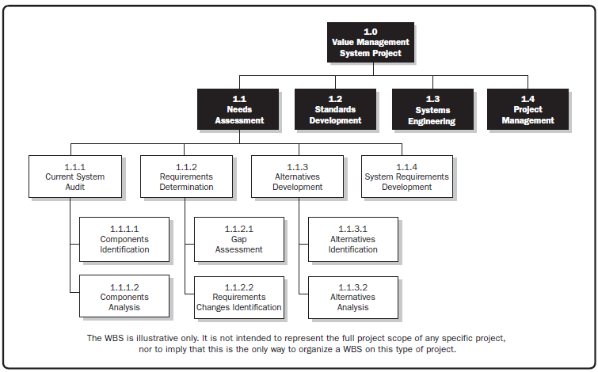

Slide 6
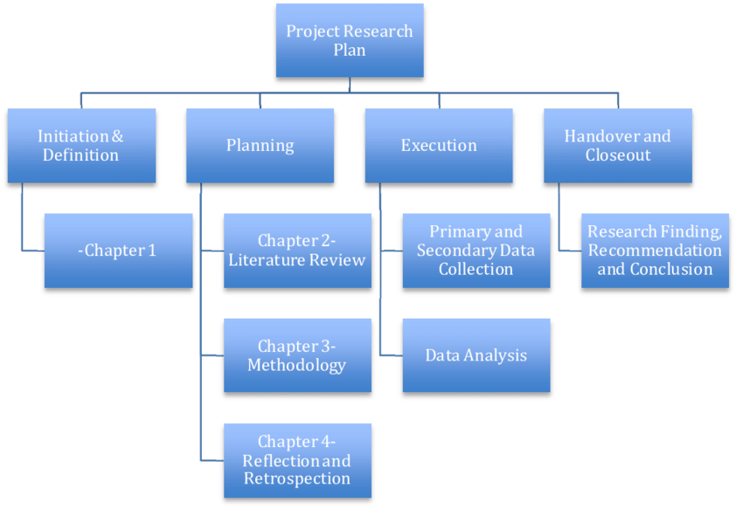

Slide 7
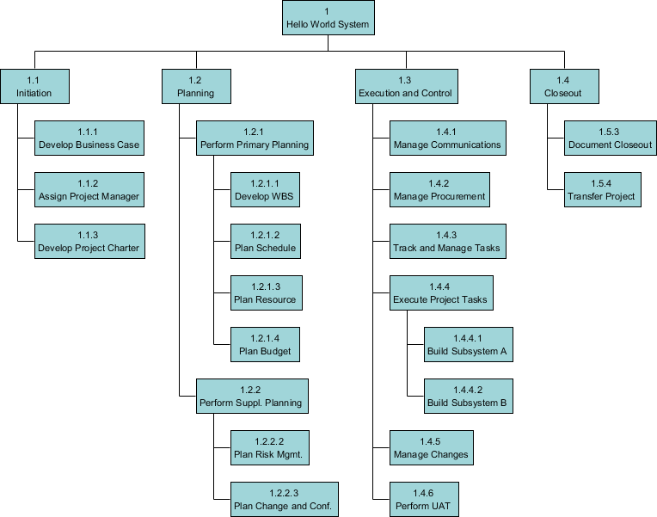

Slide 8
